Slide 1


EMC Underground: MetroLabs
MetroLabs

Slide 2
Goal
The goal of this series of labs is to provide a hands on experience in developing a Continuous Integration/Delivery pipeline to deploy an apache web server with content to serve up through the web server.
The tools used this lab series will be:
Github
Jenkins
Puppet
Docker
VirtualBox

Slide 3
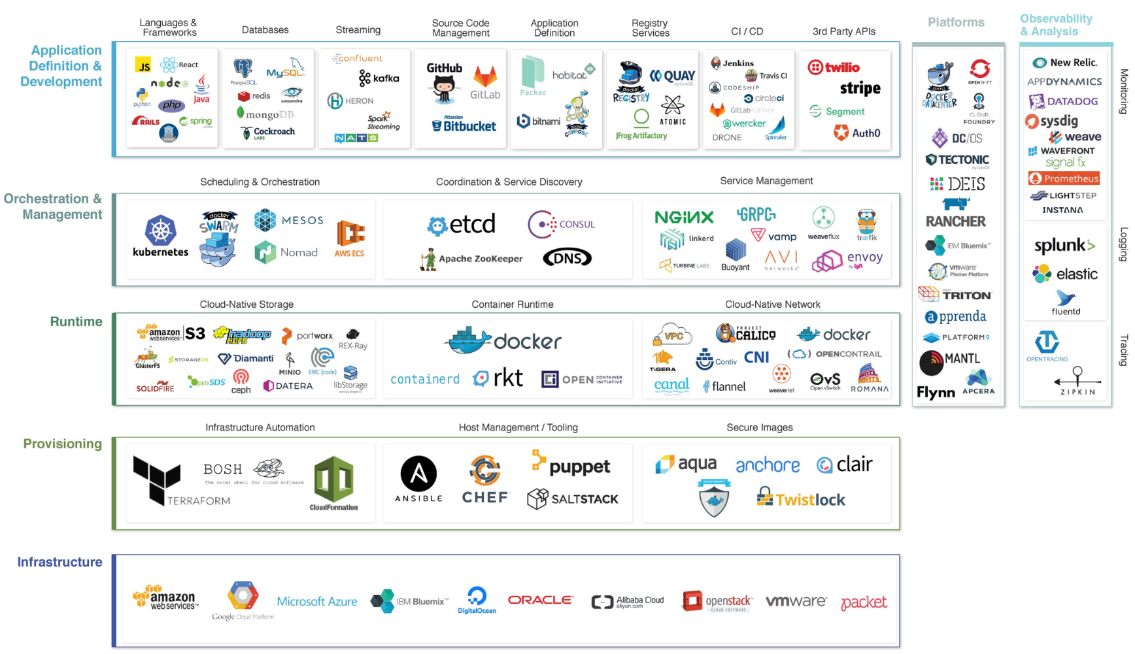
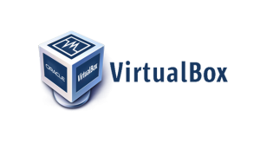
THE CLOUD NATIVE LANDSCAPE
*From Cloud Native Computing Foundation (CNCF)

Slide 4

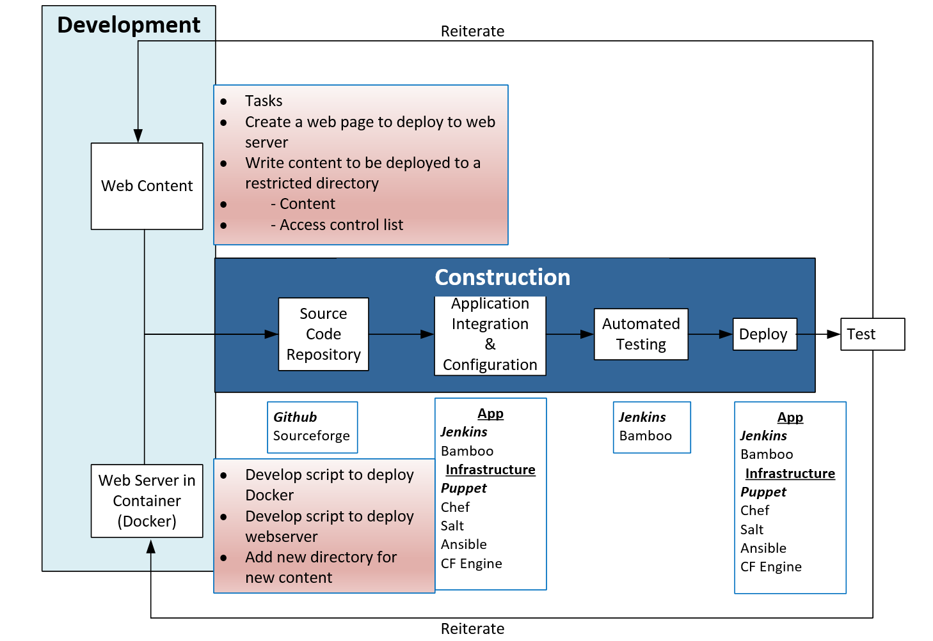

Slide 5
Review of First Session (9/29/2017)
Group Goals, Feedback, Meeting Cadence
Application Development evolution
Cloud Native Development Landscape
DevOps
Agile
Sprints / Scrums
CI/CD

Slide 6
First Homework Assignment
Download VirutalBox and Ubuntu 16.04 verison
Install VirtualBox & VirtualBox Extension Pack
Create 2 Virtual Machines
Puppet Master (This will be the VM supporting Puppet and Jenkins Server)
Configure VirtualBox
2GB RAM
1 vCPU
15GB HDD
Install Ubuntu 16.04
Puppet Client (This VM is where the container will be deployed)
Configure VirtualBox
2GB RAM
1 vCPU
15GB HDD
Install Ubuntu 16.04
Thoughts?
Challenges?
Notes:
Struggles:
What did you do when there was an issue?

Slide 7


Communication is Key in DevOps Culture
DevOps requires communication and collaboration
DevOps values these skills as much as technical skill set
DevOps requires the breakdown of traditional silos
How are companies achieving this?
Scrum
Slack
Trello
Github
Notes:
Trello – Kanban
National / Global teams are key users of these tools

Slide 8
Slack for MetroLabs
Are you signed up yet?
nynjentpresales.slack.com
Exploration

Slide 9
Git & Github

Slide 10
Git and Github
Git is the distributed version control system. Git is responsible for keeping track of changes to content (usually source code files), and it provides mechanisms for sharing that content with others.
GitHub is a company that provides Git repository hosting
Git is a version control system; think of it as a series of snapshots (commits) of your code. You see a path of these snapshots, in which order they where created. You can make branches to experiment and come back to snapshots you took.
GitHub, is a web-page on which you can publish your Git repositories and collaborate with other people

Slide 11
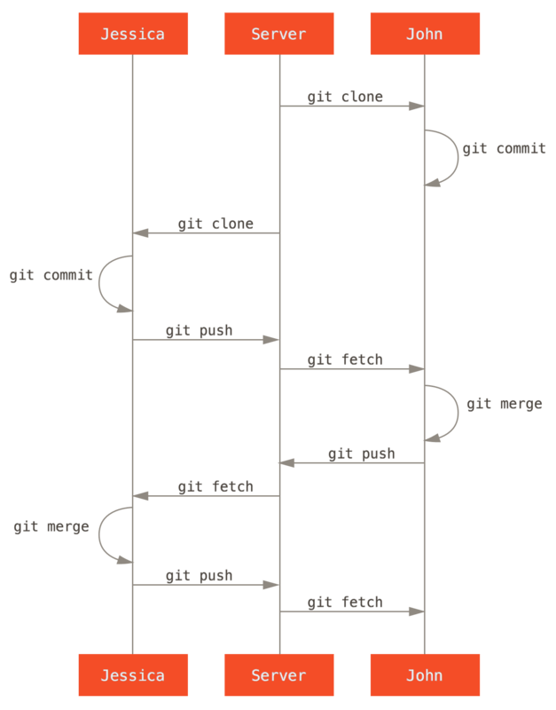
Version Control

Slide 12
Puppet

Slide 13

What is Puppet
Puppet is a open-source software configuration management tool
Developers like puppet because:
It is useful #1 when you have a helluva-lot of machines required to be configured in a similar form.
It is useful #2 when you have an infrastructure that requires the dynamic scaling-up and scaling-down of machines with a pre-determined (or at least metadata-calculated) configuration.
It is useful #3 to have control over all of your configured machines, so a centralized (master-server or repo-based) change gets propagated to all automatically.

Slide 14
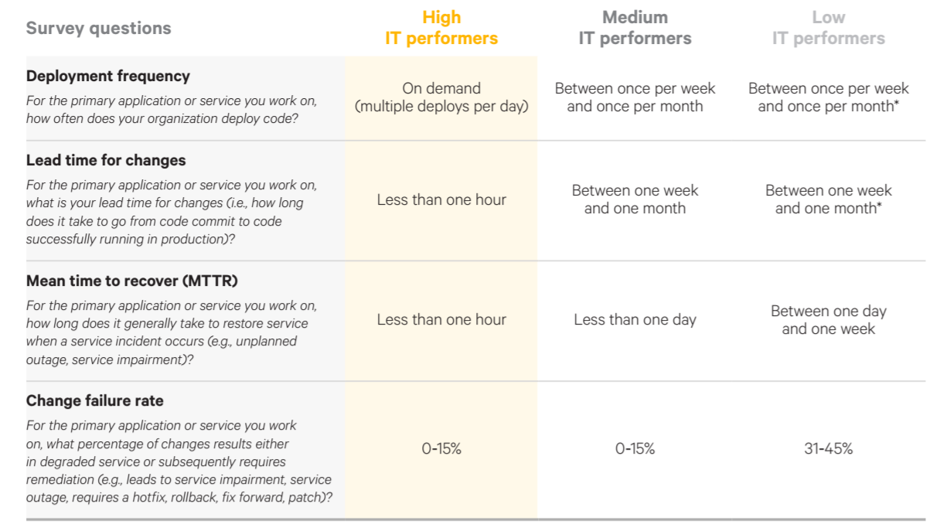
Why use automation tools?

Slide 15
Jenkins

Slide 16

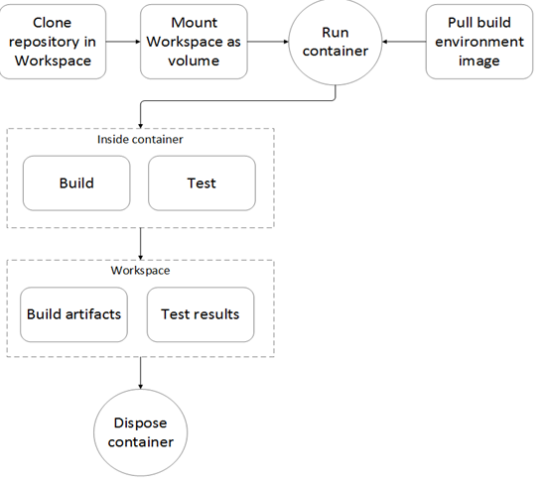
What is Jenkins?
Jenkins is an open source automation tool written in Java with plugins built for Continuous Integration purpose.
Used to build and test your software projects continuously
Making it easier for developers to integrate changes to the project,
Making it easier for users to obtain a fresh build.
Allows you to continuously deliver your software by integrating with a large number of testing and deployment technologies.
Organizations can accelerate the software development process through automation.
Integrates development life-cycle processes of all kinds, including build, document, test, package, stage, deploy, static analysis and much more.
Example of workflow using Jenkins

Slide 17
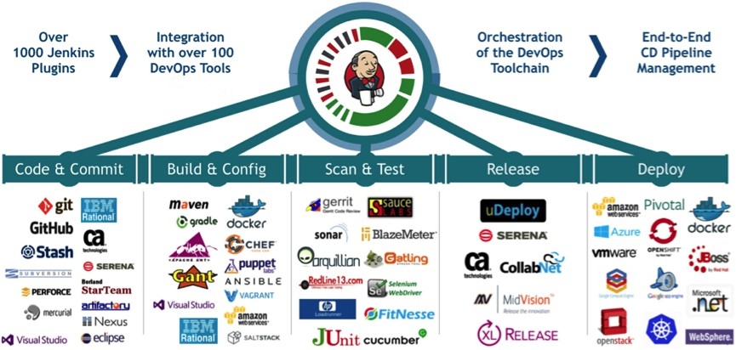
Plugins & Companies that partner with Jenkins
Jenkins achieves Continuous Integration with the help of plugins. Plugins allows the integration of Various DevOps stages. If you want to integrate a particular tool, you need to install the plugins for that tool. For example: Git, Maven 2 project, Amazon EC2, HTML publisher etc.

Slide 18
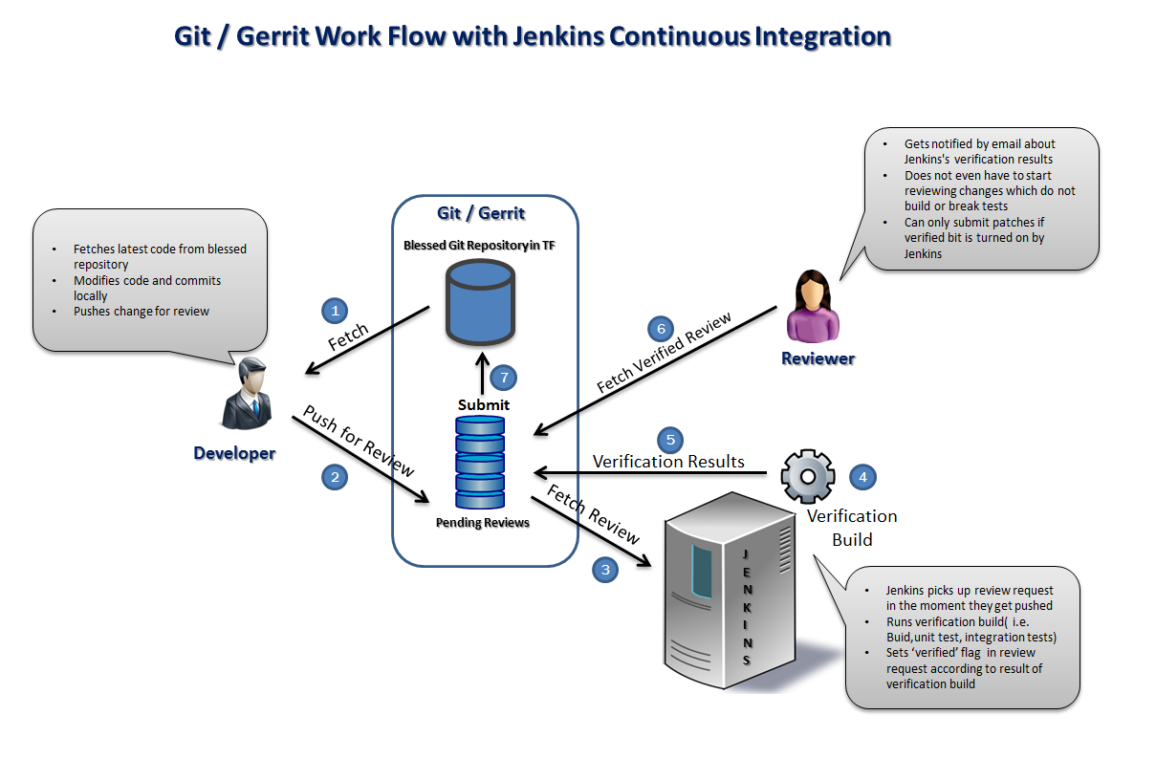

Slide 19
Environment

Slide 20
Environment
Internet
Virtualization Platform
(VirtualBox)
GitHub.com
Client VM
Master VM
Source Code Management
Ubuntu 16.04
Open Puppet Agent
Docker
Web Server
Content
Ubuntu 16.04
Open Puppet
Jenkins Server

Slide 21
Tools
Laptop
Virtualization Platform (VirtualBox)
Github.com (Source Code Control)
Puppet (Configuration Management)
Jenkins (Continuous Integration & Delivery)

Slide 22
VM Network Environment
External Network (NAT)
Internet
Master
Client
Internal Network (Host-only Adapter)

Slide 23
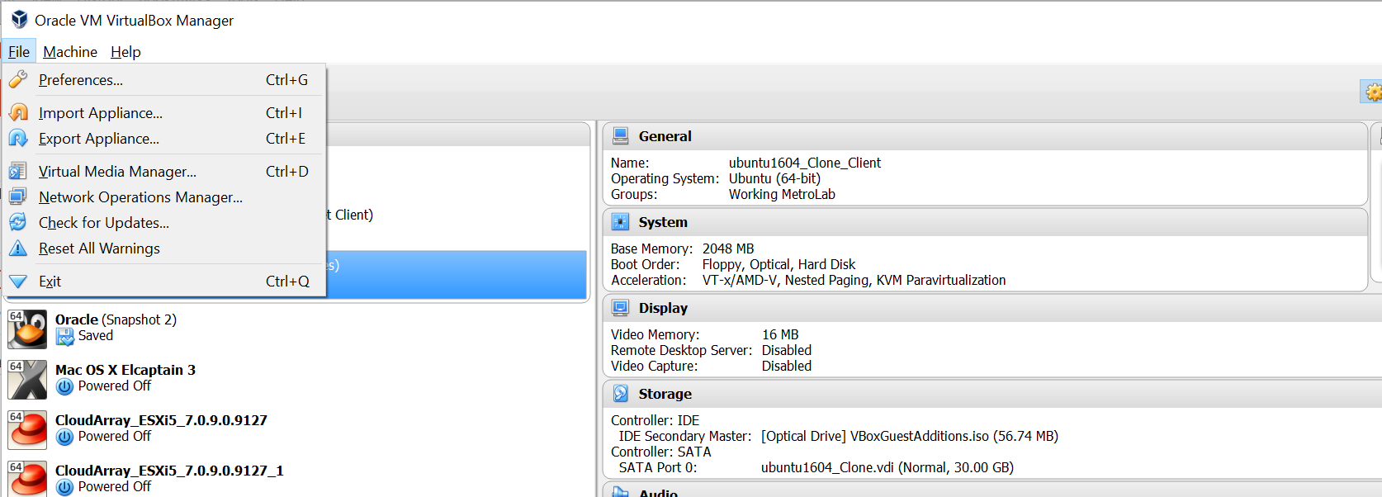
Create Host Only Network
Select Preferences

Slide 24
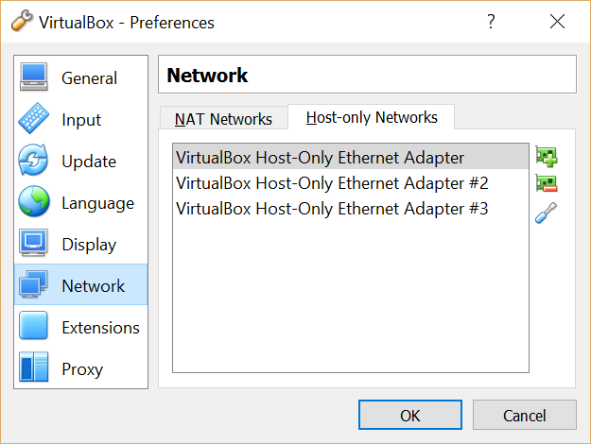
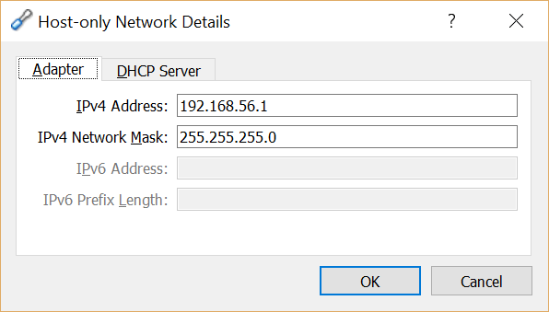
Add Host-Only Network
Write down IP Address
This will be used for adding static IP addresses to the Ubuntu VMs
Verify that there is a Host-Only Adapter configured
Select Network
Click Screwdriver to view network settings.

Slide 25
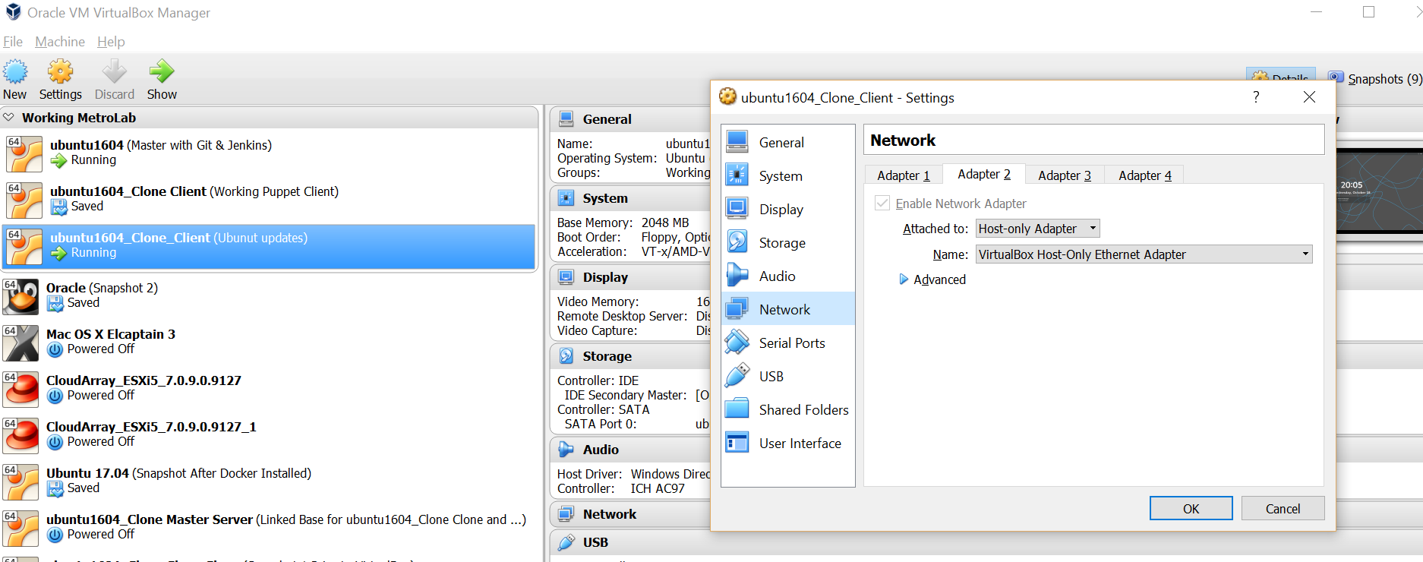
Attach Host Only Network to VM
Select VM
Select Network

Slide 26
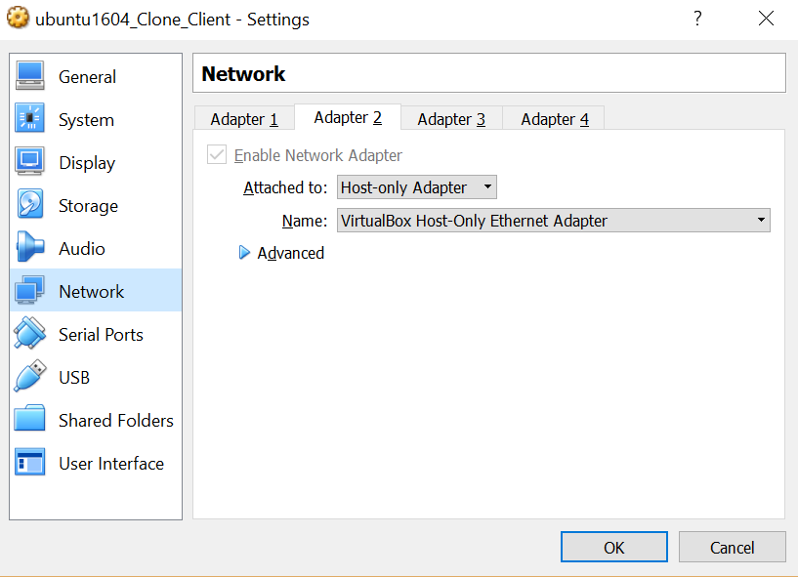
Attach Host Only Network to VM
Select Adapter 2
Host-only Adapter
VirtualBox Host-Only Ethernet Adapter

Slide 27
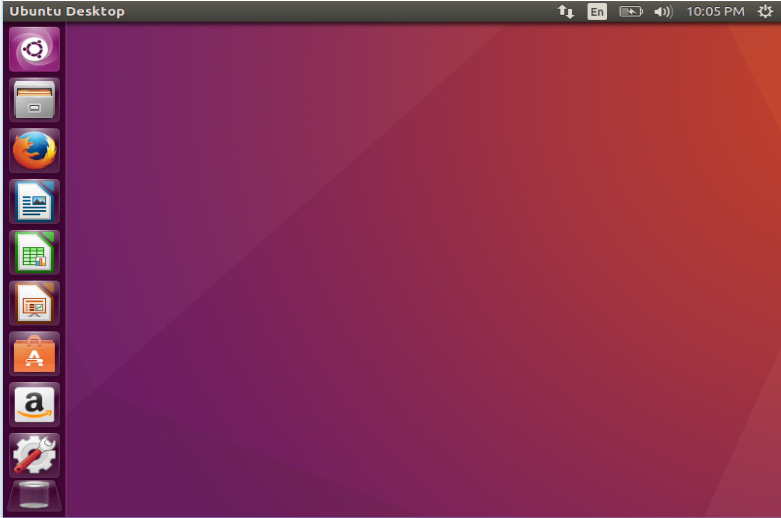
Assign Static IP Address
Select the network button
Then Select ‘Connection Information’

Slide 28
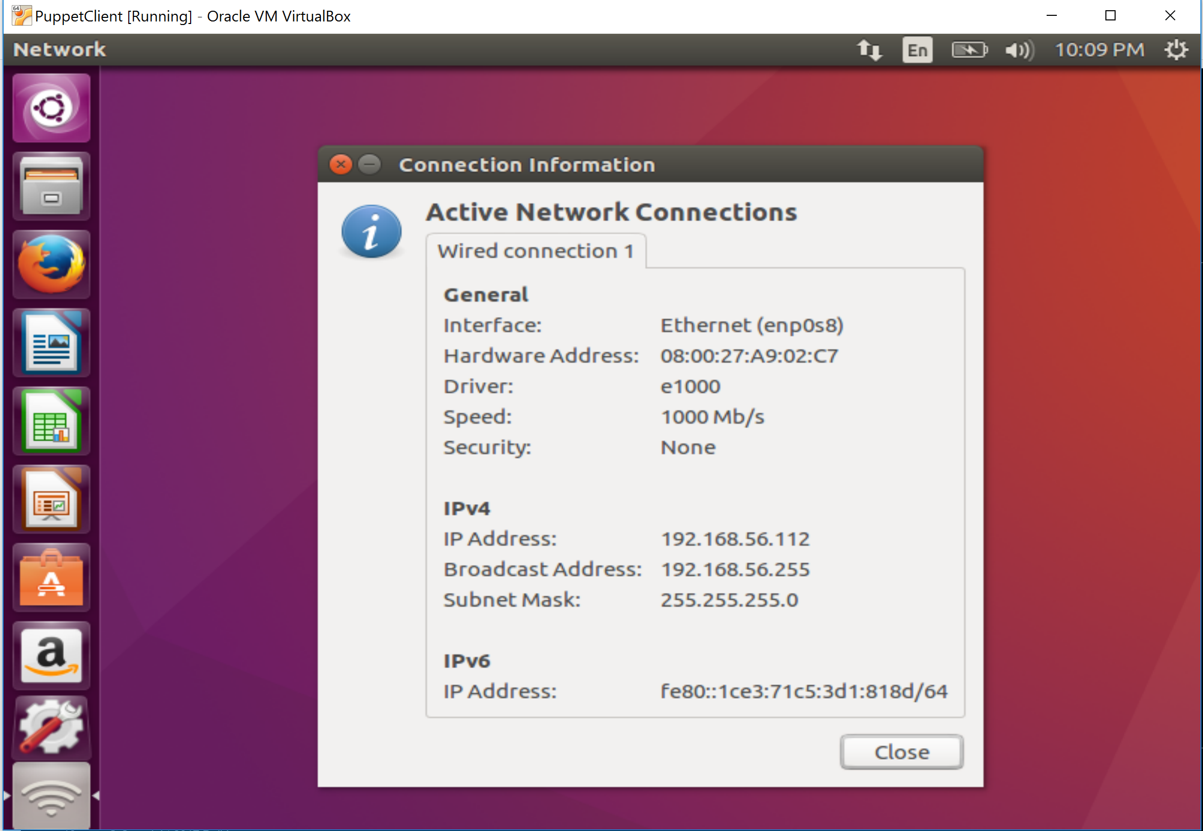
Assign Static IP Address
Select the network button
Then Select ‘Connection Information’
Note the Interface and Hardware Address

Slide 29
Assign Static IP Address
Close Connection Information
Select the network button
Then Select ‘Edit Connections’

Slide 30
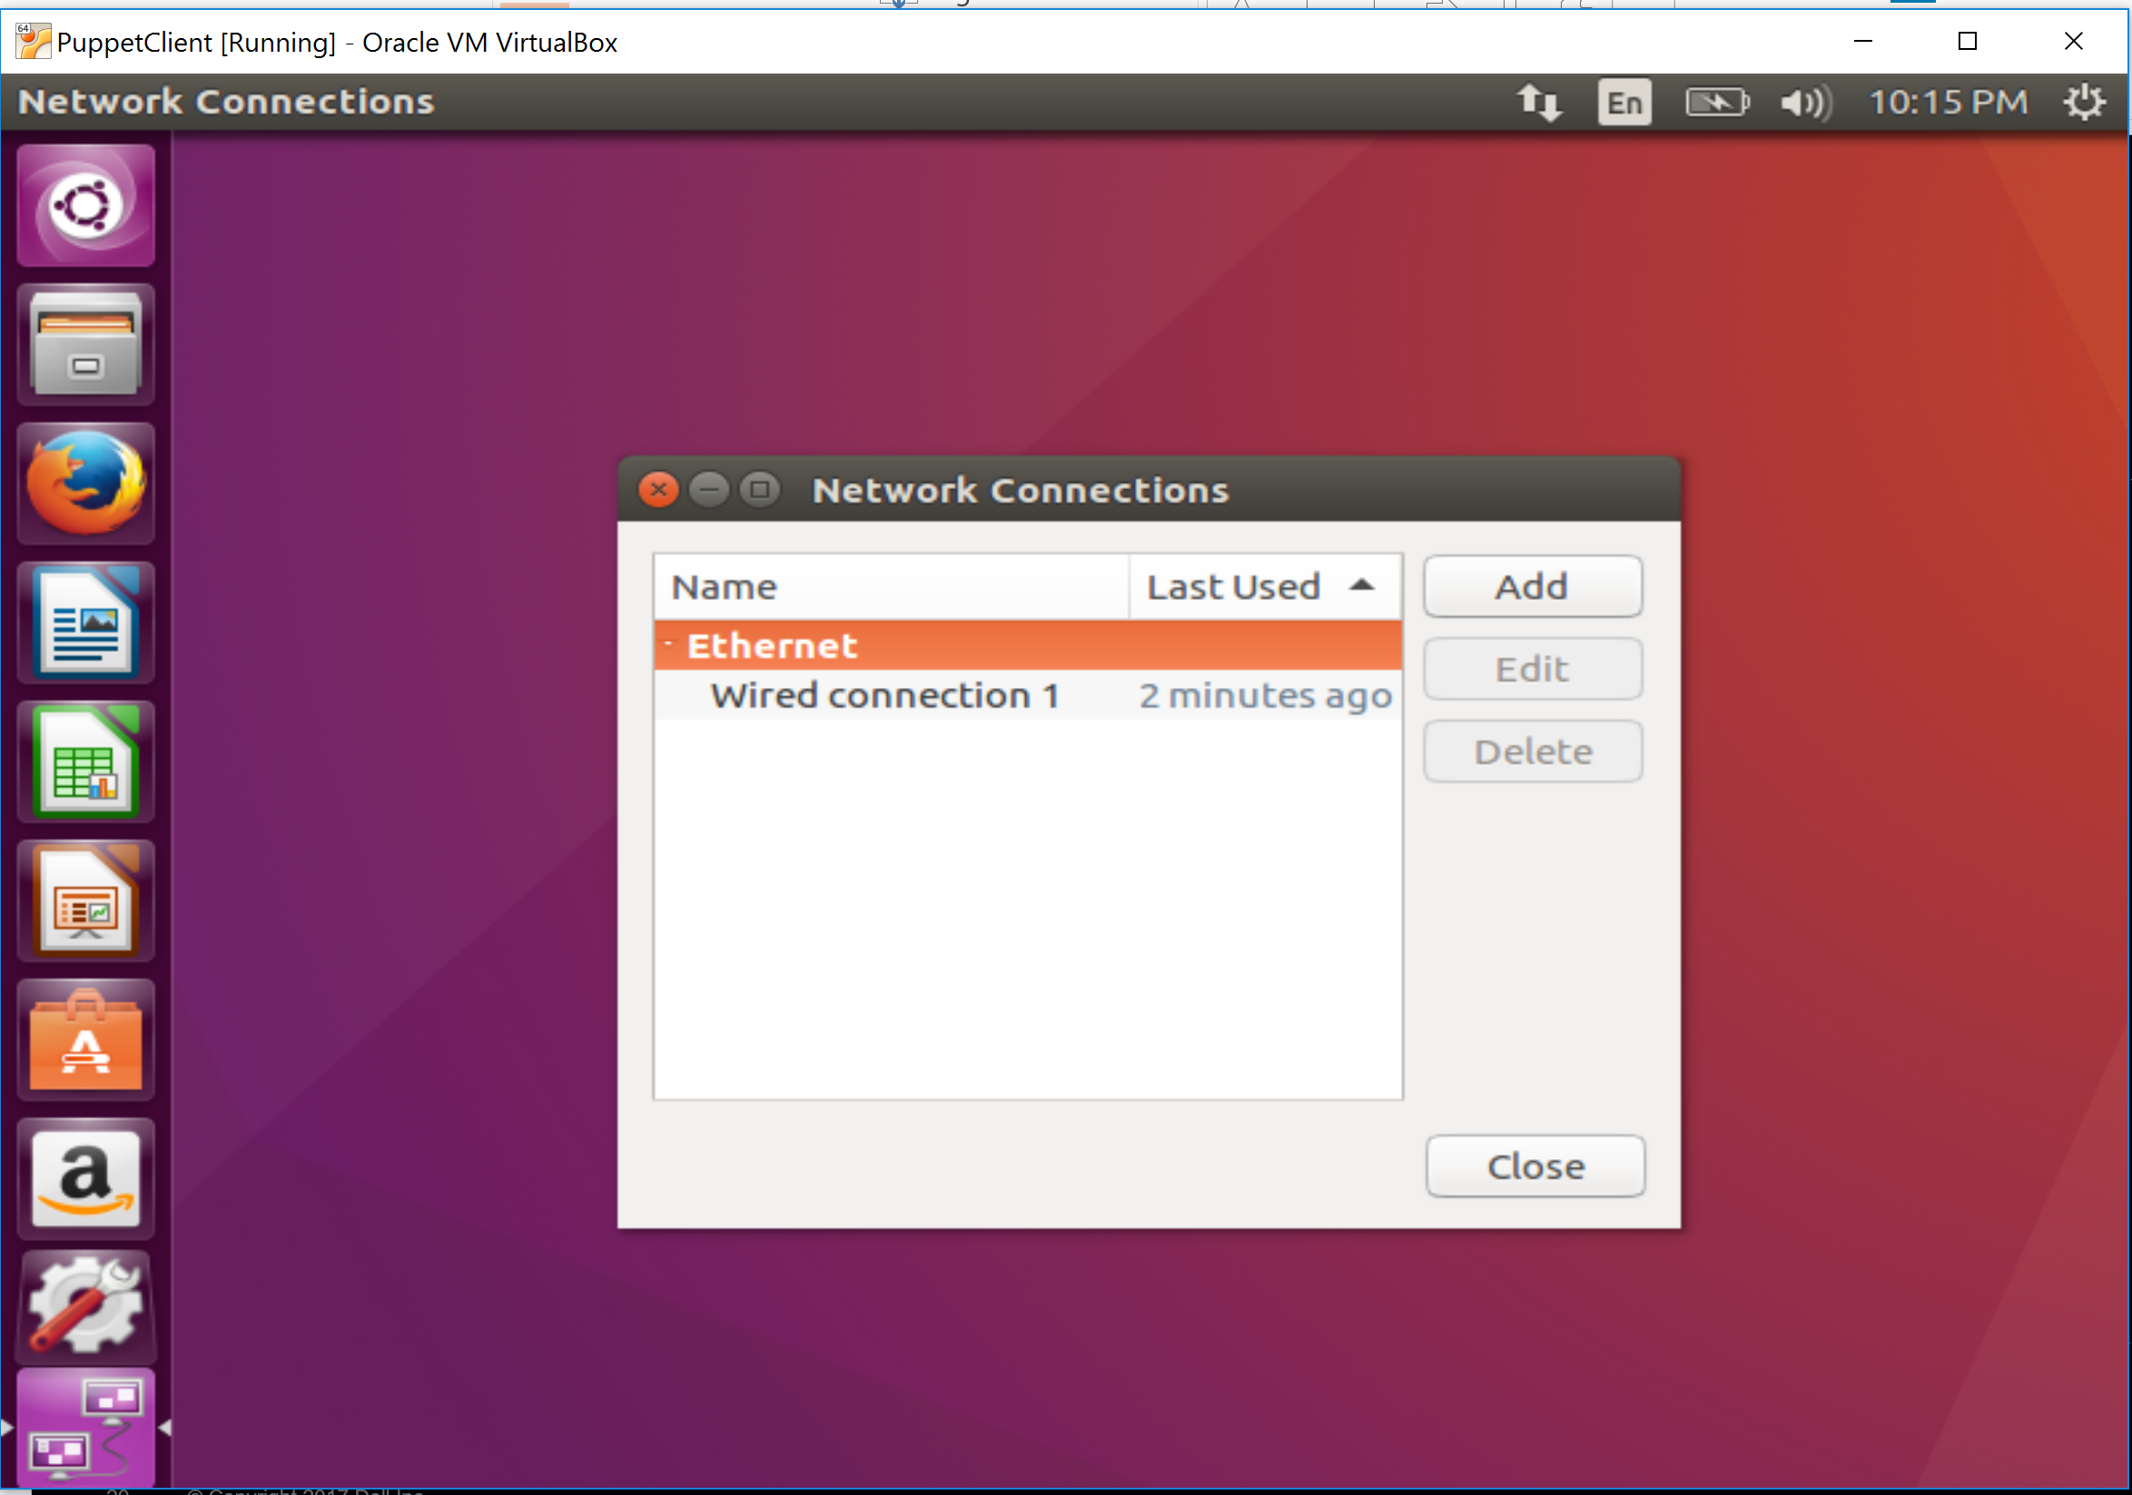
Assign Static IP Address
Select ‘Add’

Slide 31
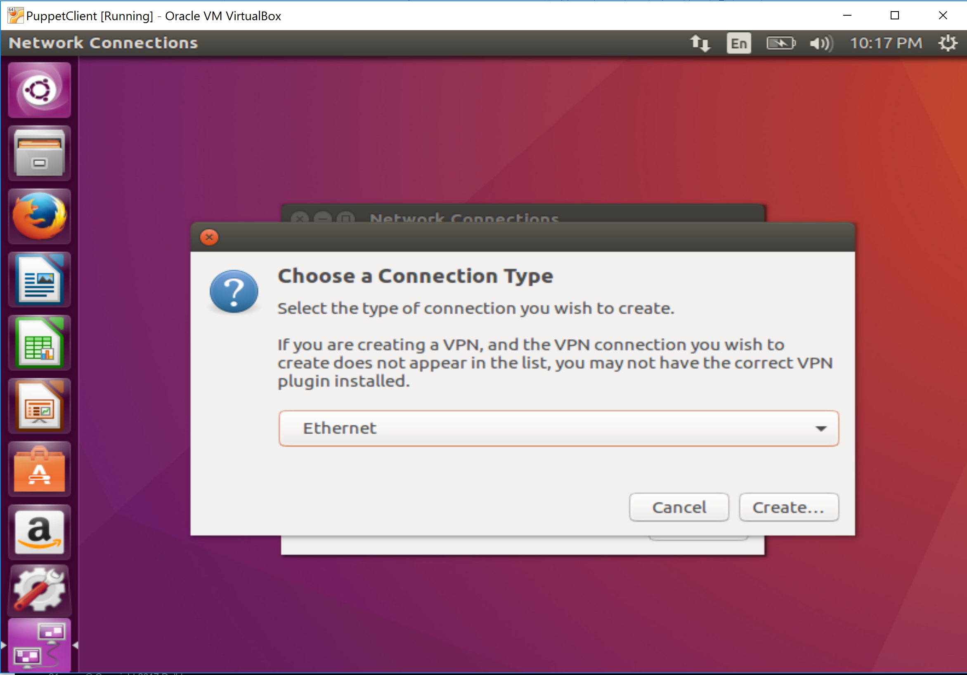
Assign Static IP Address
Leave as Ethernet
Select ‘Create’

Slide 32
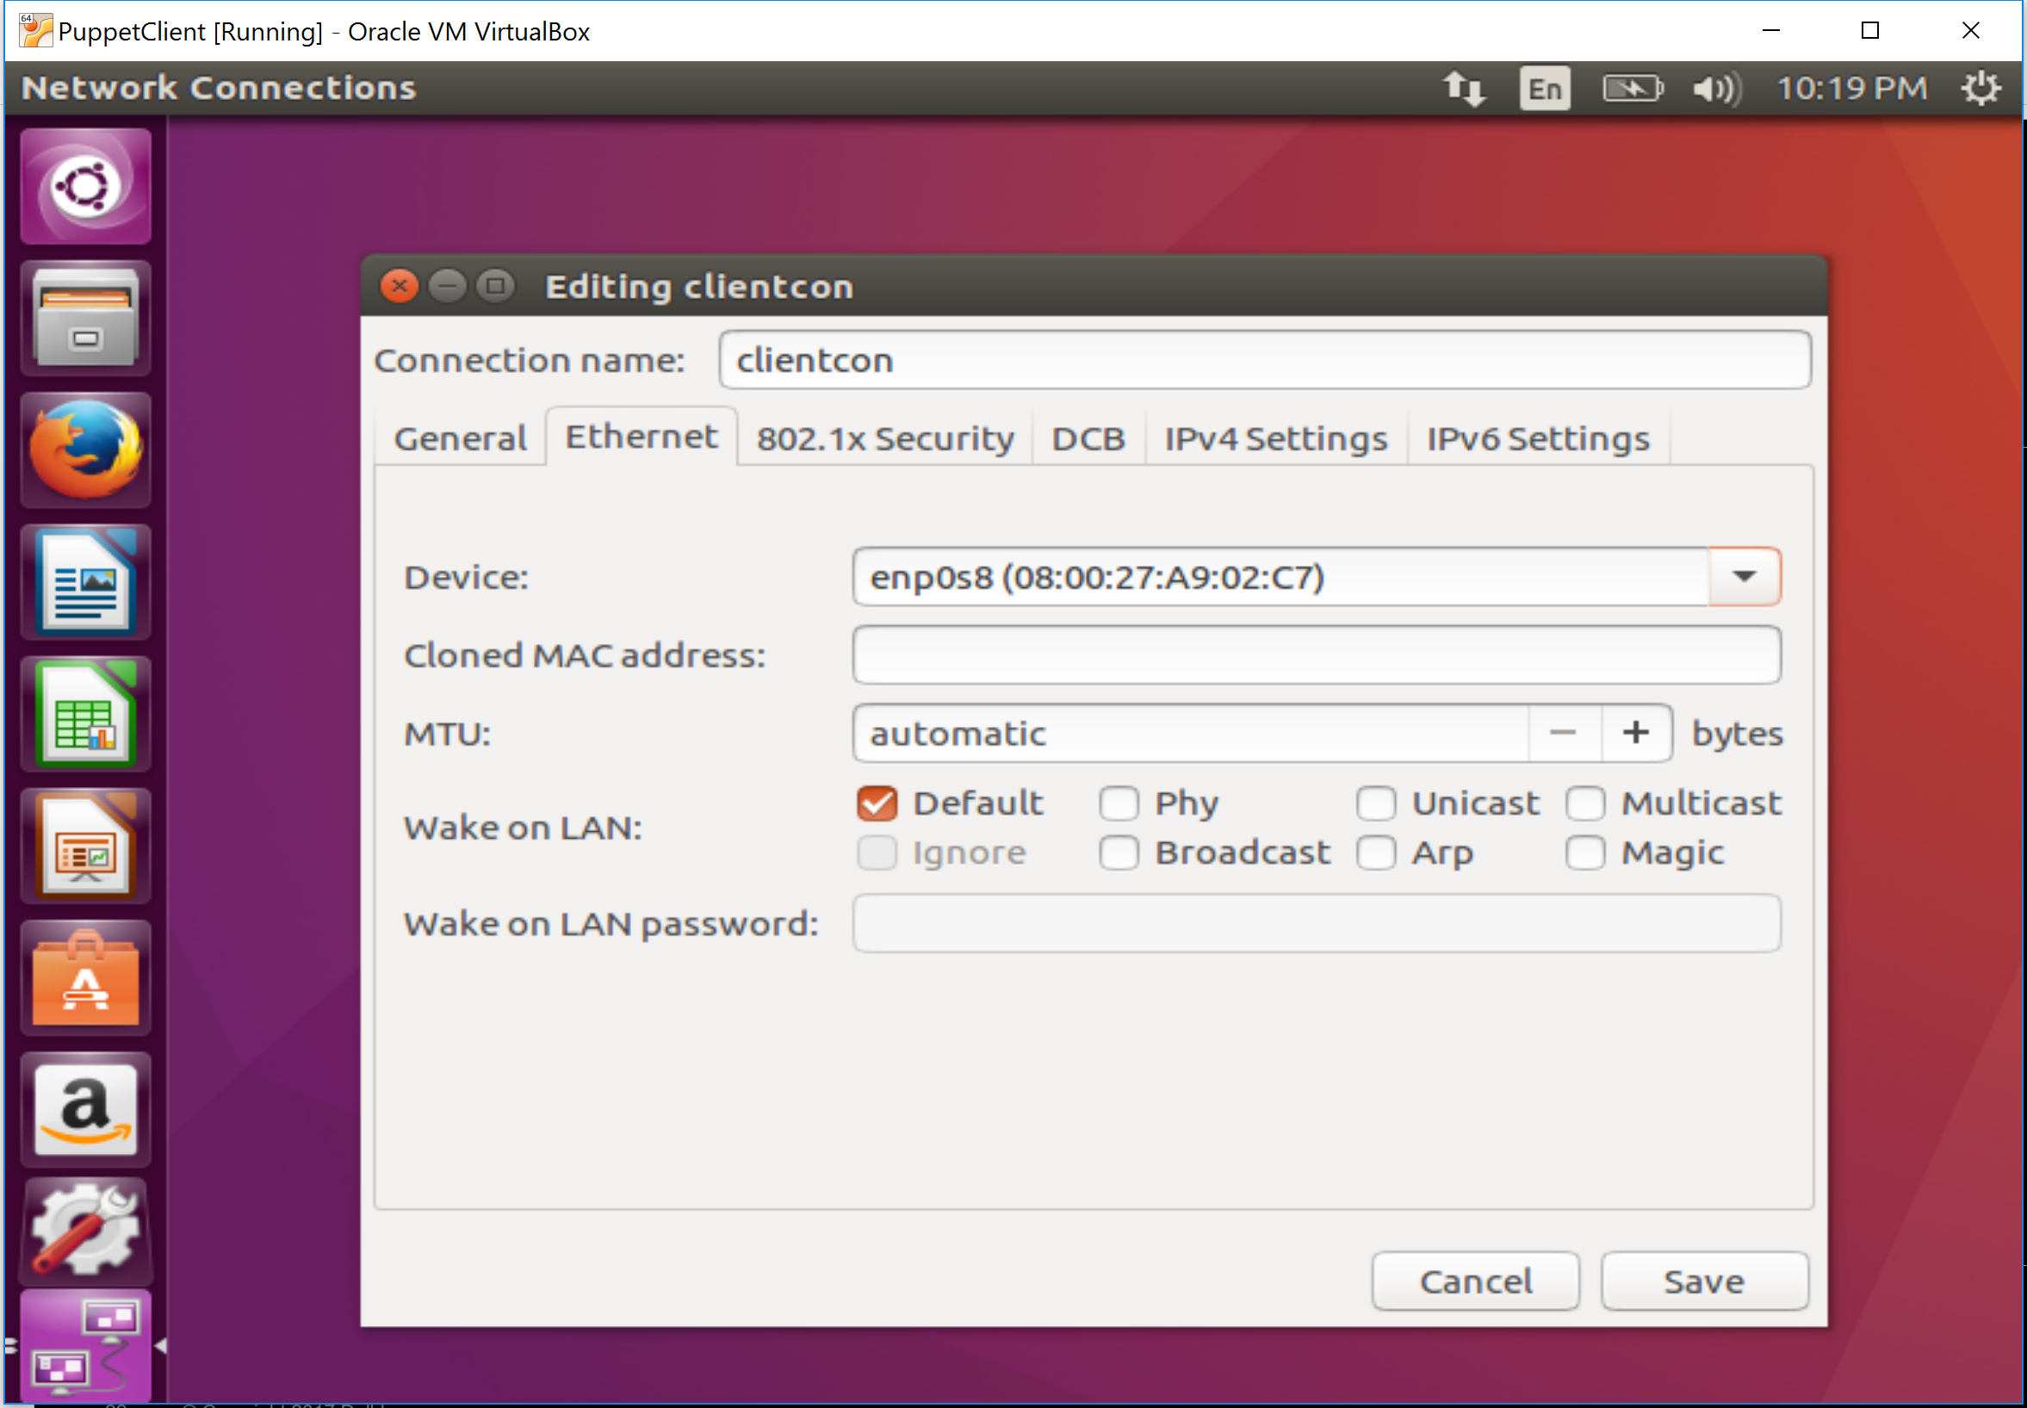
Assign Static IP Address
Name connection (i.e. mastercon)
Set device to the prior noted interface

Slide 33
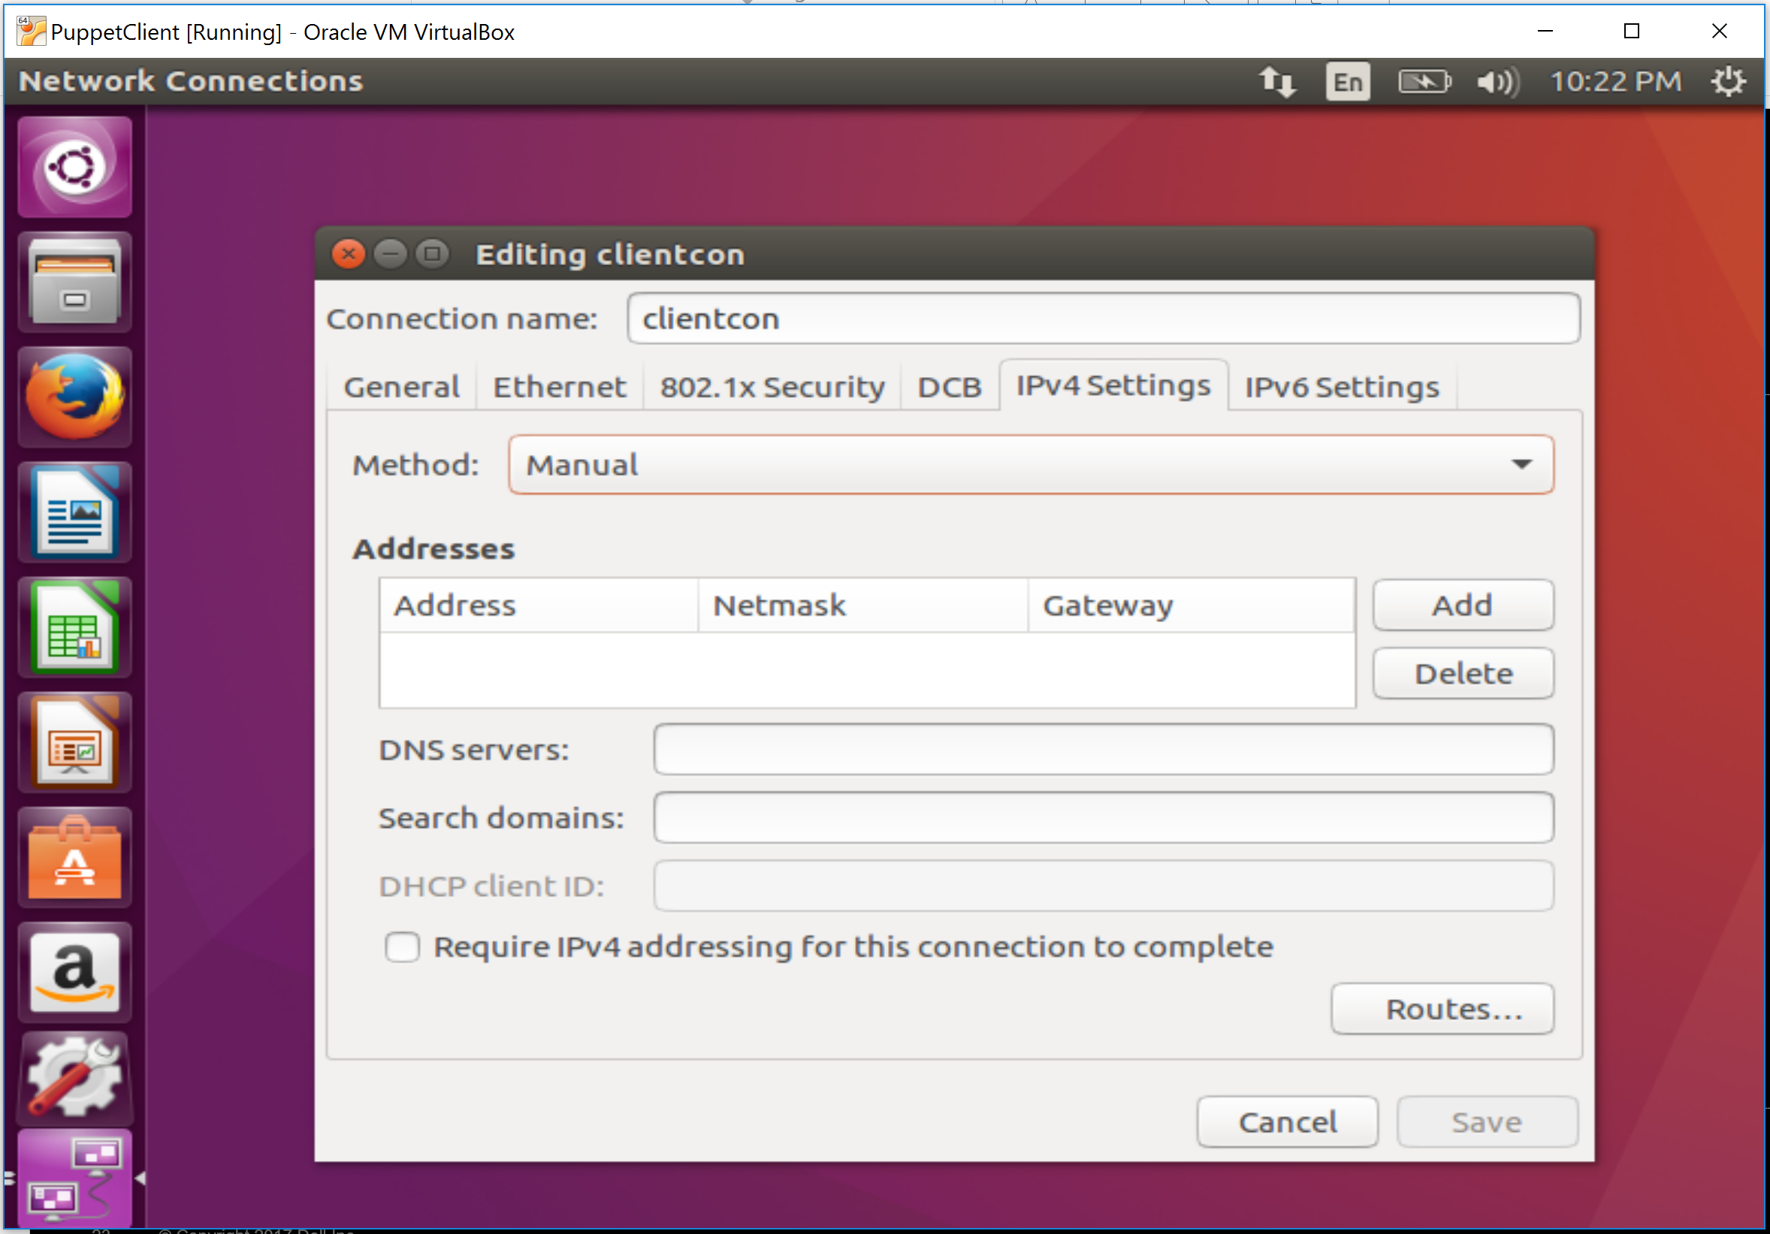
Assign Static IP Address
Select IPv4 Settings
Change Method to Manual

Slide 34
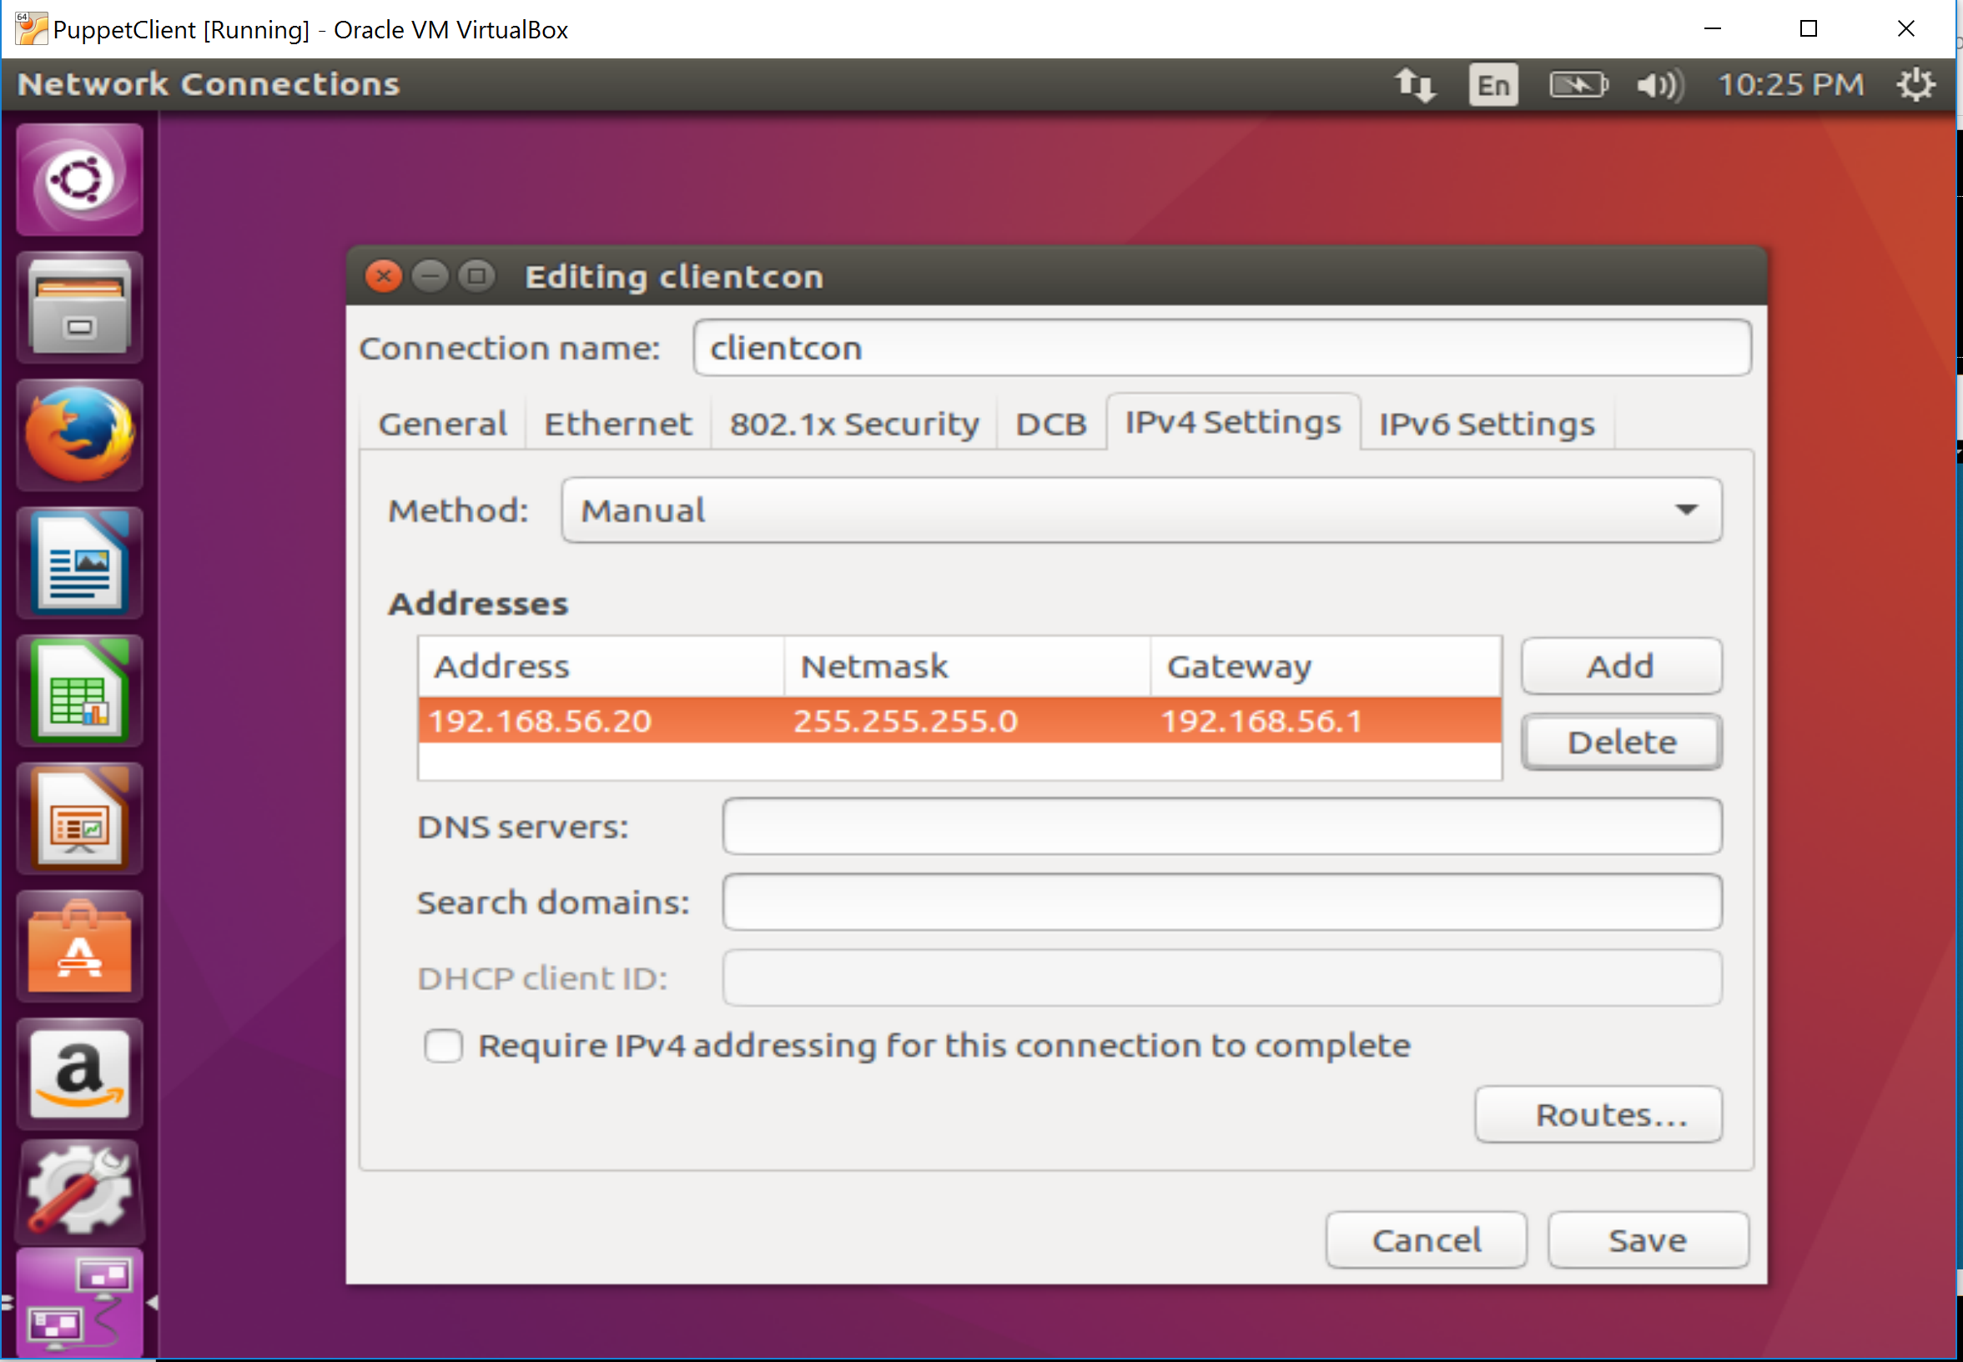
Assign Static IP Address
Add an address and make it a static IP. Make the master x.x.x.10 and the client x.x.x.20.

Slide 35
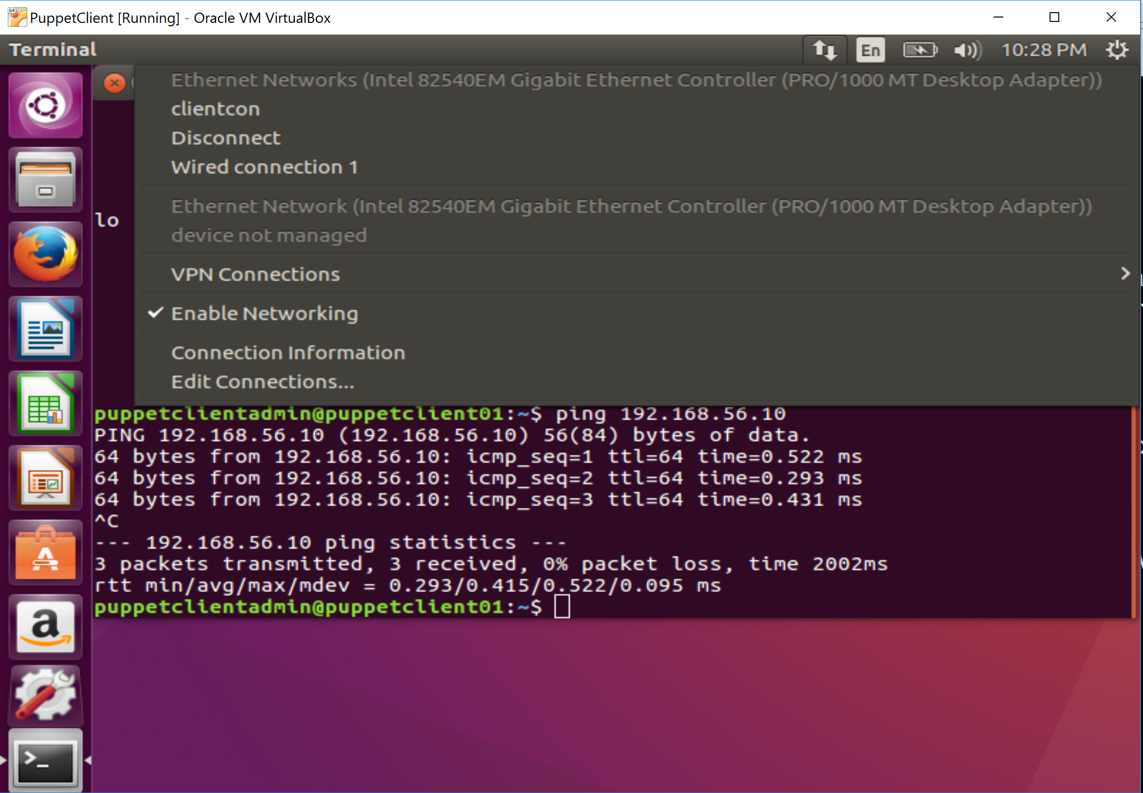
Assign Static IP Address
Save the profile, then set it active by selecting it in the network menu

Slide 36
Repeat this process for the 2nd VM

Slide 37
Creating a Github Account

Slide 38
Create a GitHub Account
https://github.com/join

Slide 39
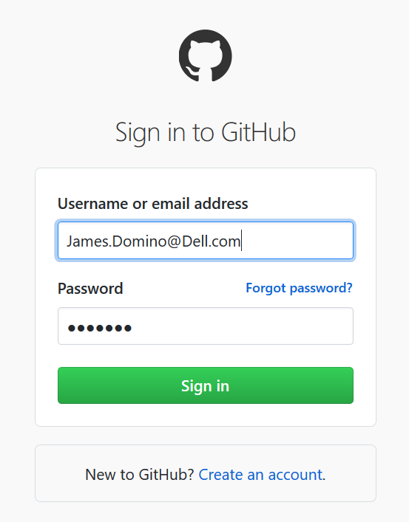
Login Into Github
https://github.com/login

Slide 40
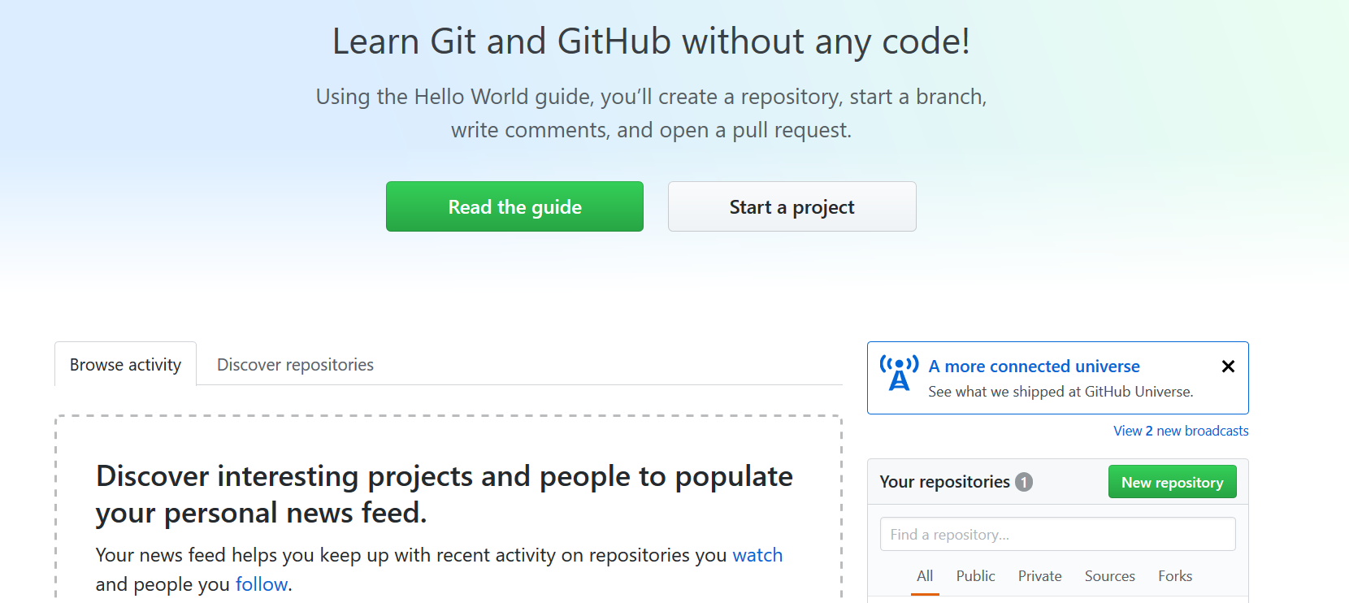
Create a New Repository
Create a Github repository.

Slide 41
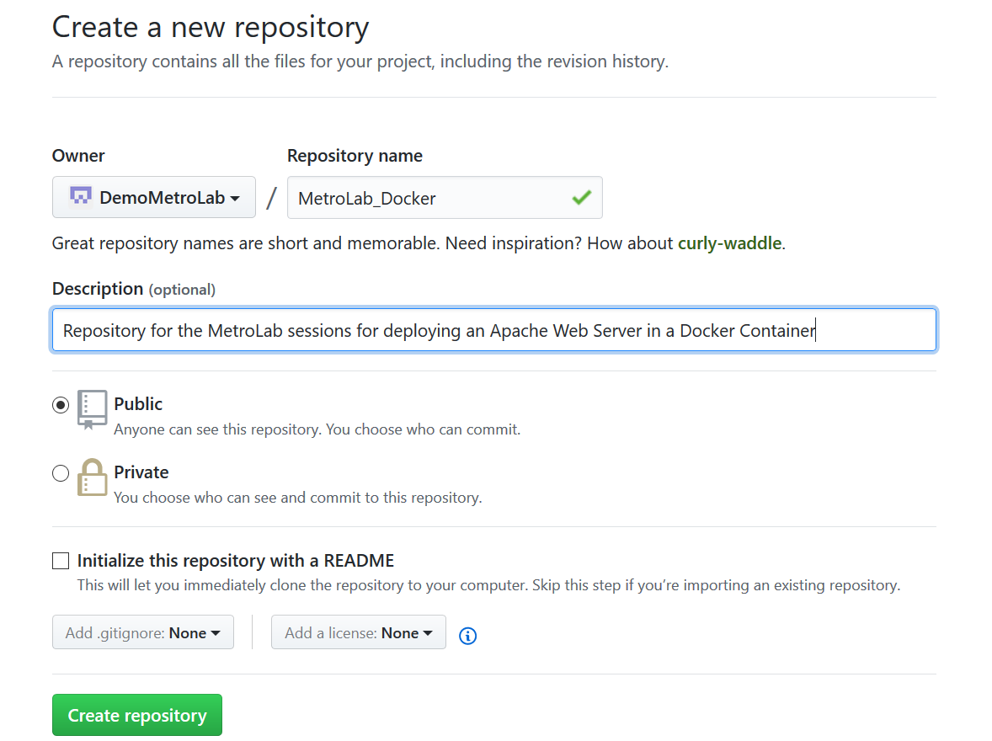
Creating a New Repository
Pick a name for your repository.
Add a description.

Slide 42
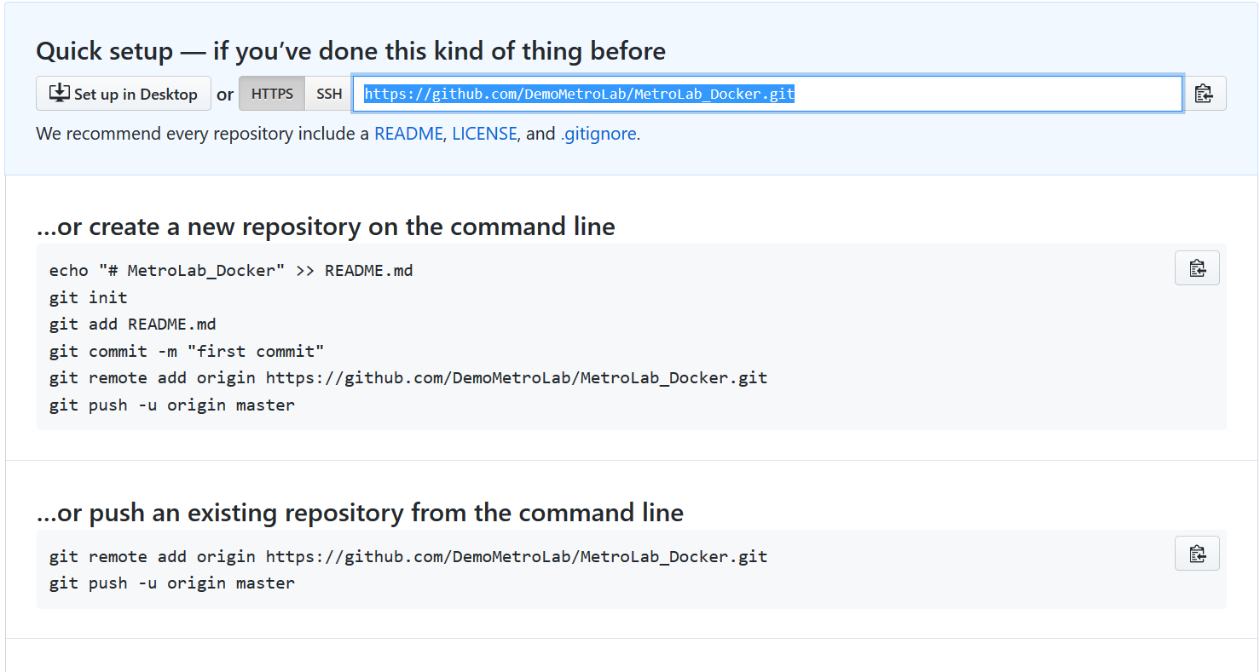
Remote Repository Created
Make note of the repository URL, will need this later to upload files and pull files.

Slide 43
Testing Git and Github
Start the VM
Login into VM
Open a Terminal Window
$ cd /opt
$ sudo mkdir MetroLab_Docker
$ cd MetroLab_Docker
$ sudo git init
This will Initialize the git repository
$ sudo bash
Currently logged in as puppet, this switches to Root user, and $ switches to #

Slide 44
Testing Git and Github
Execute the following in a Terminal Window in the VM
# echo "echo \"Hello World\"" > helloworld.sh
Creates a file called helloworld.sh that contains the text echo “Hello World”
# git status
You will see the following as your file is picked up by git.
On branch master
Initial commit
Untracked files:
(use "git add <file>..." to include in what will be committed)
helloworld.sh
nothing added to commit but untracked files present (use "git add" to track)

Slide 45
Testing Git and Github
# git add helloworld.sh
# git status
On branch master
Initial commit
Changes to be committed:
(use "git rm --cached <file>..." to unstage)
new file: helloworld.sh
# git commit -m "Testing pushing to MetroLab_Docker Repository in Github"
# Commits the tracked changes and prepares them to be pushed to a remote repository. To remove this commit and modify the file, use 'git reset --soft HEAD~1' and commit and add the file again.
Notes:
git config --global user.email "puppetmaster@emc.com" git config --global user.name "Puppet Master"

Slide 46
Prepare Local Git Repository to Push to Remote
# git remote -v
Shows that there is nothing in the repository
# git remote add origin <Remote_Repository_URL>
Enter in your site
Sets the new remote - https://github.com/DemoMetroLab/MetroLab_Docker.git
# git remote -v
Verifies the new remote repository
URLoriginhttps://github.com/DemoMetroLab/MetroLab_Docker.git (fetch)
origin https://github.com/DemoMetroLab/MetroLab_Docker.git (push)
# git ls-tree -r master --name-only
Verify file in remote repository
helloworld.sh

Slide 47
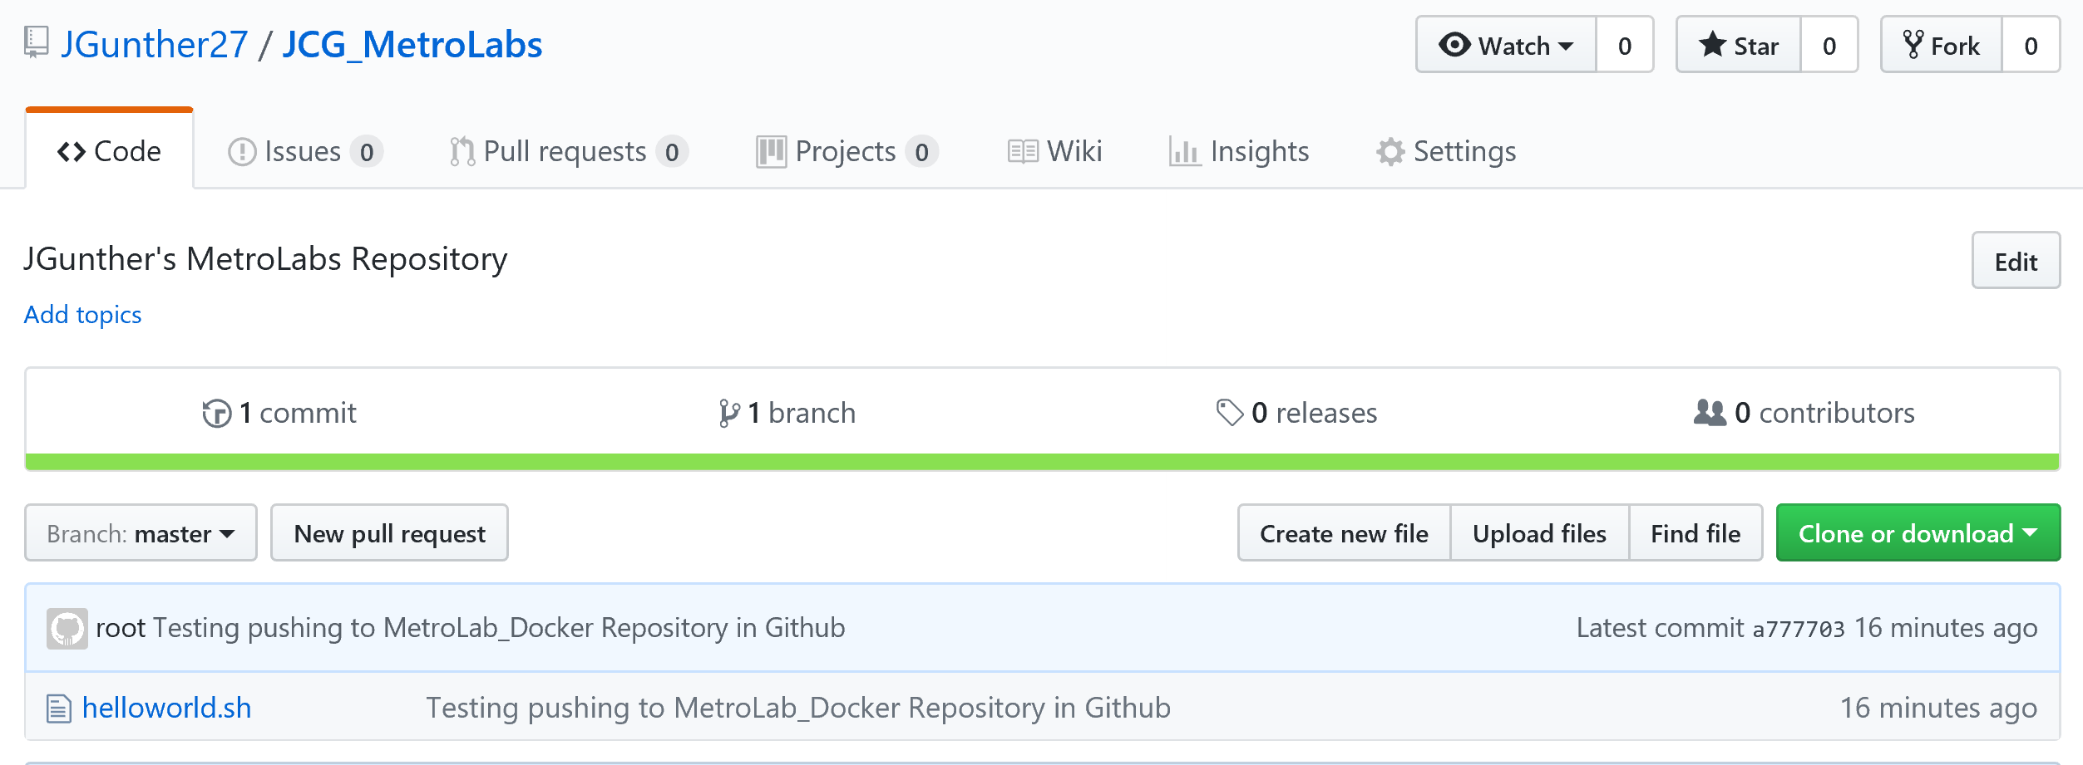
Prepare Local Git Repository to Push to Remote
# git push origin master
Username for 'https://github.com': James.Domino@Dell.com
Password for 'https://James.Domino@Dell.com@github.com':
Counting objects: 3, done.
Writing objects: 100% (3/3), 277 bytes | 0 bytes/s, done.
Total 3 (delta 0), reused 0 (delta 0)
To https://github.com/DemoMetroLab/MetroLab_Docker.git
* [new branch] master -> master
Refresh your github screen to Verify helloworld.sh file in github repository

Slide 48
Installing Puppet

Slide 49
Installing Puppet
Start the VM
Login into VM
Open a Terminal Window

Slide 50
Puppet
$ wget https://apt.puppetlabs.com/puppet5-release-xenial.deb
Download the “puppetlabs-release” package for your OS version.
You can see a full list of these packages on the front page of https://apt.puppetlabs.com/. They are all named puppetlabs-release-<CODE NAME>.deb. (For Ubuntu releases, the code name is the adjective, not the animal.)
Architecture is handled automatically; there is only one package per OS version.
$ sudo dpkg -i puppet5-release-xenial.deb
Install the package by running dpkg -i <PACKAGE NAME>.
$ sudo apt-get update
Run apt-get update to get the new list of available packages.

Slide 51
Installing Puppet
Install Puppet on the Puppet Master Server
On your Puppet master, run:
$ sudo apt-get install puppetserver
Install Puppet on Client Nodes
On your Puppet Client, run:
$ sudo apt-get install puppet

Slide 52
Puppet Post Installation Steps on Puppet Master
In the [main] section of the master’s puppet.conf file, set the dns_alt_names setting to a comma-separated list of each hostname the master should be allowed to use:
$ sudo bash
# cd /etc/puppetlabs/puppet
# echo “dns_alt_names = puppet,puppet.emc.com,PuppetMaster.corp.emc.com,PuppetMaster” >> puppet.conf

Slide 53
Modifying Puppet.conf file to Add Host Names on Puppet Client
$ vi puppet.conf
Edit the puppet.conf file,
Type a to insert the file
Down Arrow to last line of [main]
Type in dns_alt_names = PuppetClient1.corp.emc.com,puppetClient1
Hit escape, then :wq! To save
Should look like this:
[main]
logdir=/var/log/puppet
vardir=/var/lib/puppet
ssldir=/var/lib/puppet/ssl
rundir=/run/puppet
factpath=#vardir/lib/facter
prerun_command=/etc/puppet/etckeeper-commit-pre
postrun_command=/etc/puppet/etckeeper-commit-post
dns_alt_names = PuppetClient1.corp.emc.com,puppetClient1

Slide 54
Adding Hostnames to Host File on both Puppet Master & Client
$ vi /etc/hosts
# Edit the /etc/hosts file to add correct IP’s
127.0.0.1 localhost
#127.0.1.1 PuppetMaster.corp.emc.com PuppetMaster
# The following lines are desirable for IPv6 capable hosts
::1 localhost ip6-localhost ip6-loopback
ff02::1 ip6-allnodes
ff02::2 ip6-allrouters
192.168.56.10 PuppetMaster.corp.emc.com puppet PuppetMaster
192.168.56.20 PuppetClient1.corp.emc.com puppetClient1

Slide 55
Creating CA Certificate – To be Ran on Puppet Master Server
For CA Masters If this is the only puppet master in your deployment, or if it will be acting as the CA server for a multi-master site, you should now run:
# apt install puppet-common
# puppet master --verbose --no-daemonize
This will create the CA certificate and the puppet master certificate, with the appropriate DNS names included.
Once it says Notice: Starting Puppet master version <VERSION>, type ctrl-C to kill the process.

Slide 56
Installing Jenkins

Slide 57
Installing Jenkins Server on Puppet Master Server
Installing Jenkins
# wget -q -O - https://pkg.jenkins.io/debian/jenkins-ci.org.key | sudo apt-key add -
# sudo sh -c 'echo deb http://pkg.jenkins.io/debian-stable binary/ > /etc/apt/sources.list.d/jenkins.list'
# sudo apt-get update
# sudo apt-get install jenkins

Slide 58
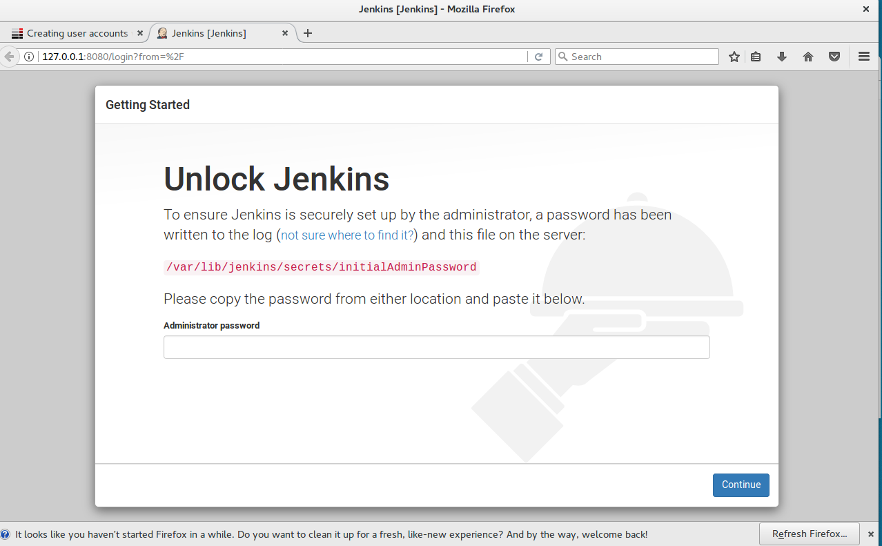
First Login to Jenkins
Launch Firefox, browse to: http://127.0.0.1:8080
From Terminal window, cat /var/lib/Jenkins/secrets/initialAdminPassword
Highlight and copy password
Paste into Firefox window

Slide 59
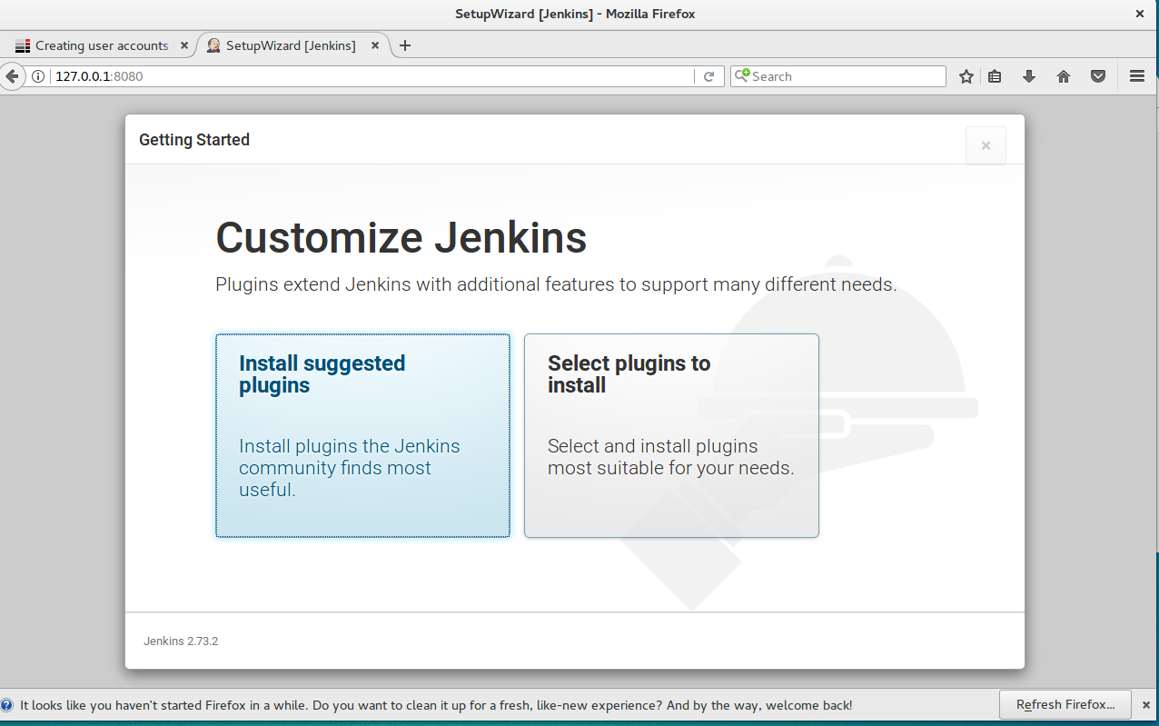
Jenkins Plugins
Click install suggested Plugins

Slide 60
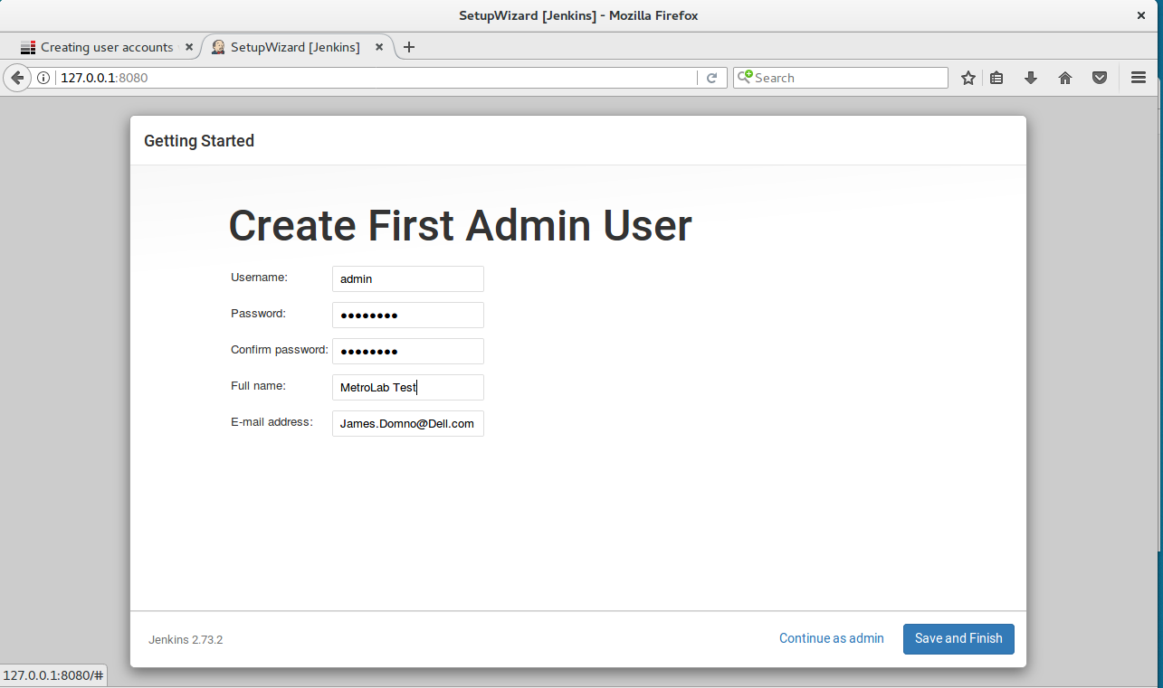
Create First Admin User & Password
ID: admin
PWD: M3tr0Lab

Slide 61
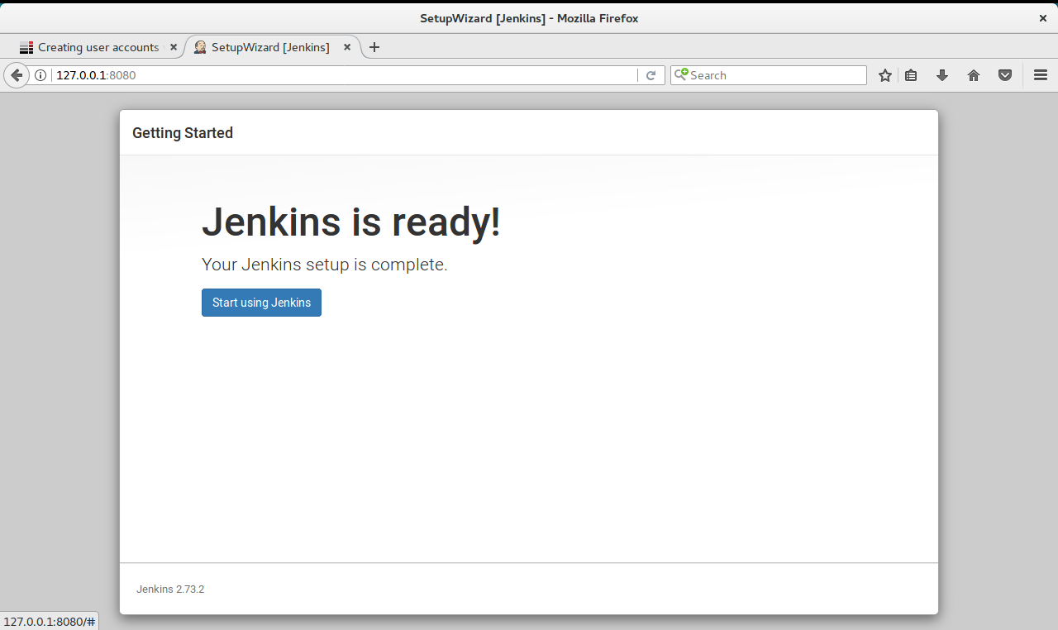
Jenkins Installed
Click Start using Jenkins

Slide 62
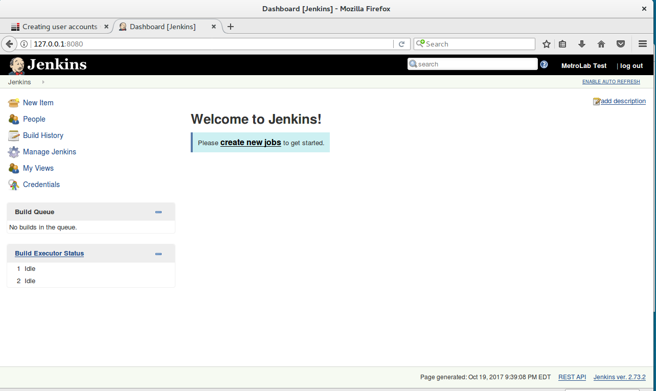

Slide 63
Session Summary
Configured Network for VMs
Created a Github account and tested access from VM
Installed Puppet
Master
Client
Installed Jenkins

Slide 64
Questions?

Slide 65
Thank You

